Slide 1
ECE 530 Cloud Computing
Ioannis Papapanagiotou
Sharding

Slide 2

What about the “shards”?
The caching components running in tier two are central to the responsiveness of tier-one services
Basic idea is to always used cached data if at all possible, so the inner services (here, a database and a search index stored in a set of files) are shielded from “online” load
We need to replicate data within our cache to spread loads and provide fault-tolerance
But not everything needs to be “fully” replicated. Hence we often use “shards” with just a few replicas
1
1
1
1
1
1
2
2
2
2
2
1
2
1
2
Shards
1
2
DB
Index

Slide 3
What is Sharding?
Sharding (horizontal scaling) is the process of storing data records across multiple machines.
As the size of the data increases, a single machine may not be sufficient to store the data, nor provide an acceptable read and write throughput.
With sharding, you add more machines to support data growth and the demands of read and write operations.
How?
Since the tables are divided and distributed into multiple servers, the total number of rows in each table in each database is reduced.
This reduces index size, which generally improves search performance.
A database shard can be placed on separate hardware, and multiple shards can be placed on multiple machines, greatly improving performance.

Slide 4
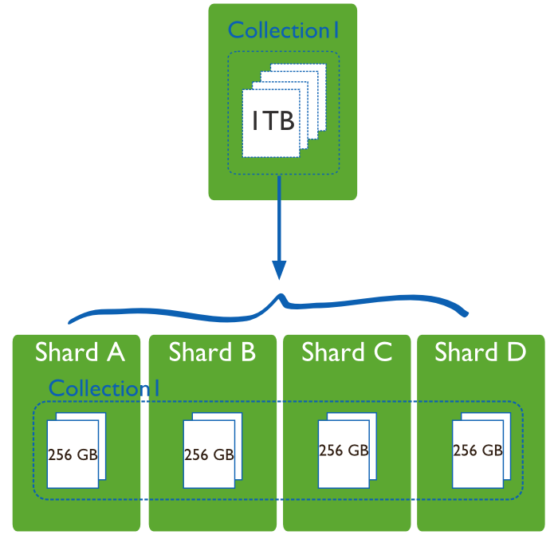
Sharding used in many ways
The second tier could be any of a number of caching services:
Memcached/Redis: a sharable in-memory key-value store
Other kinds of DHTs that use key-value APIs
Dynamo: A service created by Amazon as a scalable way to represent the shopping cart and similar data
BigTable: A very elaborate key-value store created by Google and used not just in tier-two. Built on GFS.
IBM WebSphere eXtreme Scale
Notion of sharding is cross-cutting
Most of these systems replicate data to some degree

Slide 5
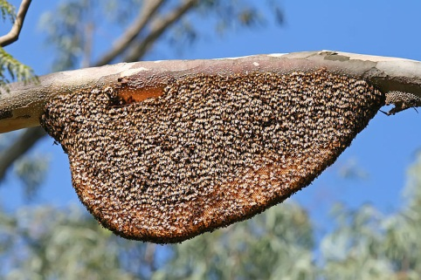
Do we always need to shard data?
Imagine a tier-one service running on 100k nodes
Can it ever make sense to replicate data on the entire set?
Yes, if some kinds of information might be so valuable that almost every external request touches it.
Must think hard about patterns of data access and use
Some information needs to be heavily replicated to offer blindingly fast access on vast numbers of nodes
The principle is similar to the way Beehive operates.
Even if we don’t make a dynamic decision about the level of replication required, the principle is similar
We want the level of replication to match level of load and the degree to which the data is needed on the critical path

Slide 6
And it isn’t just about updates
Should also be thinking about patterns that arise when doing reads (“queries”)
Some can just be performed by a single representative of a service
But others might need the parallelism of having several (or even a huge number) of machines do parts of the work concurrently
The term sharding is used for data, but here we might talk about “parallel computation on a shard”

